Slide 1
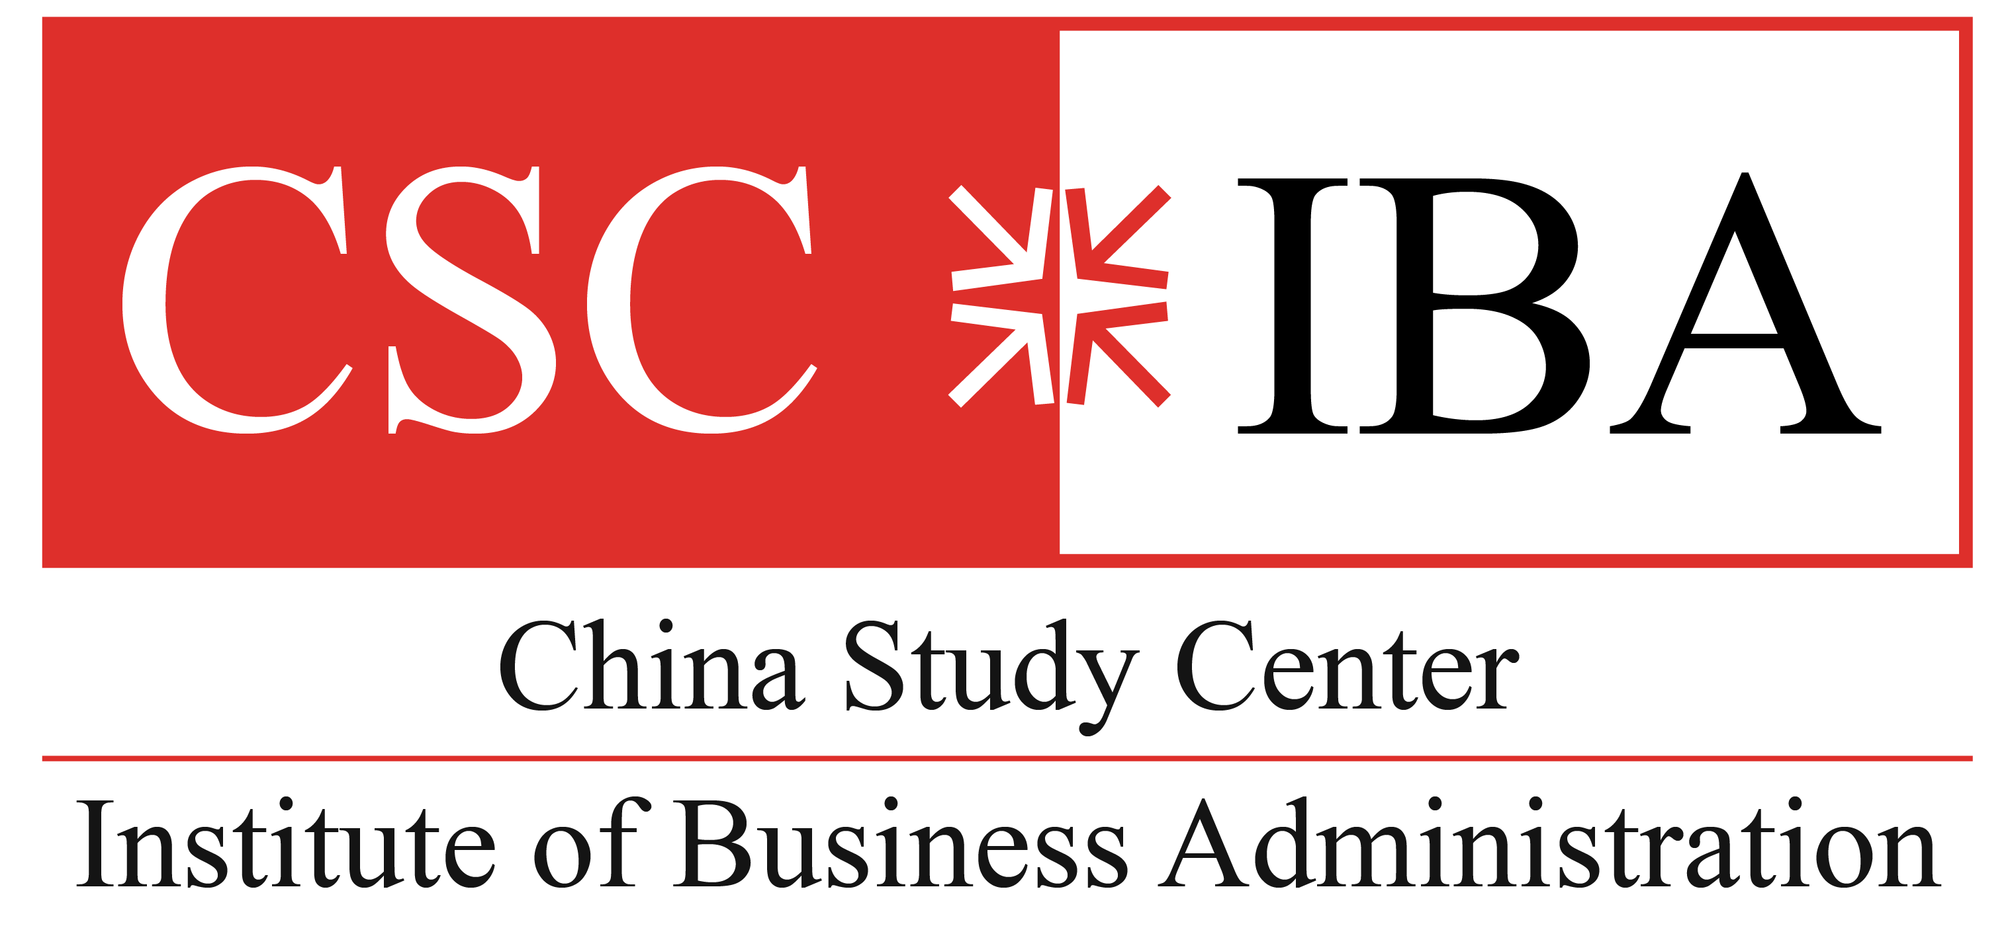
Assessment of Red Chili Value Chain in Pakistan
Conference On The China Pakistan Free Trade Agreement On Bilateral Trade & Investment
June 30, 2022, PC Hotel Karachi
Author: Dr. Nasir Afghan
Co-author & Presenter: Ans

Slide 2
Introduction of chili
Essential condiment used all over the world in a variety of forms
Chili assortments produced in Sindh are Ghotki, Lungi, Talhar, and Sanam
Ghotki assortment is long, straight or curved and has little seeds inside
Longi assortment is a little round, and full of sharp seeds and appeals to producers due to high revenue
Talhar assortment is long, thick and is a late variety
Sanam assortment is long,round,hollow, and impervious to frost and diseases

Slide 3
Objectives
Value chain - upper stream and lower stream
Import and export potential
Marketing, branding, and packaging
Issues in the supply chain including farming practices
Competitor’s Analysis- how they are increasing their market share globally
Identifying business areas for investors

Slide 4
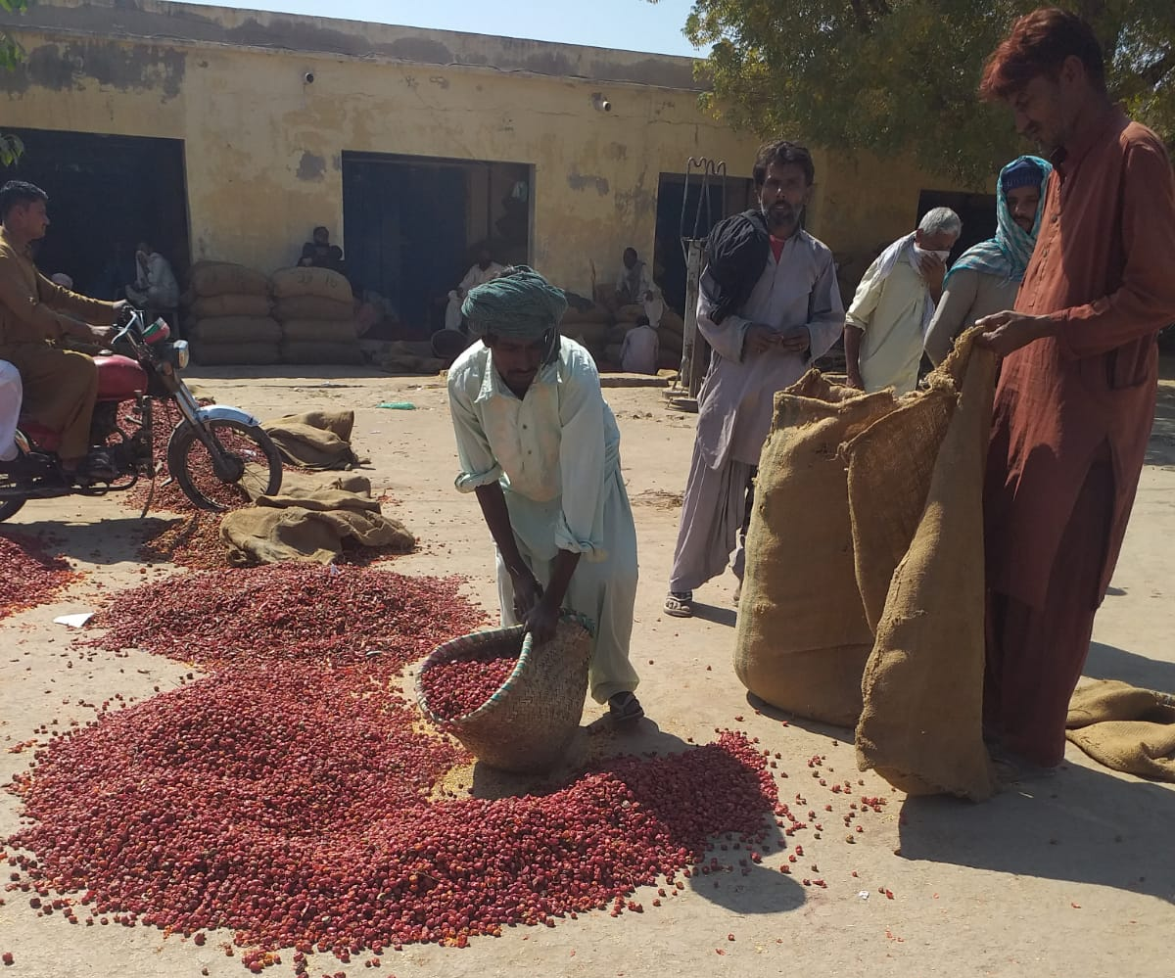
Methodology
Primary and secondary data were used
Qualitative research methodology was used for primary data collection
Secondary data research analysis from existing research reports, government reports, global statistics related to export trends, newspaper articles, and interviews.
35 interviews were taken across the value chain.
Unstructured open-ended Interview of industry expert for hands on understanding of Kunri practices.
Observation and interviews of different value chain players in Kunri- 3 bidders, 4 bidding process, 4 commission agents, 10 farm owners, Farm workers- women & children (7), Field interviews 2, Seed distributors 1.
Structured interview with Government representative
Interview of industry leaders like Shan foods and National foods- representatives from Procurement, Quality Control, Logistics department.

Slide 5
PROBLEMS IN THE LOCAL PRODUCTION
Water shortage
Quality seed unavailability
Aflatoxin
Weather conditions - excess rainfall
Cash management
Drying process
Pests and insects
Issues with local seeds
Counterfeit pesticides
Looting
Lack of Good Agriculture Practices

Slide 6
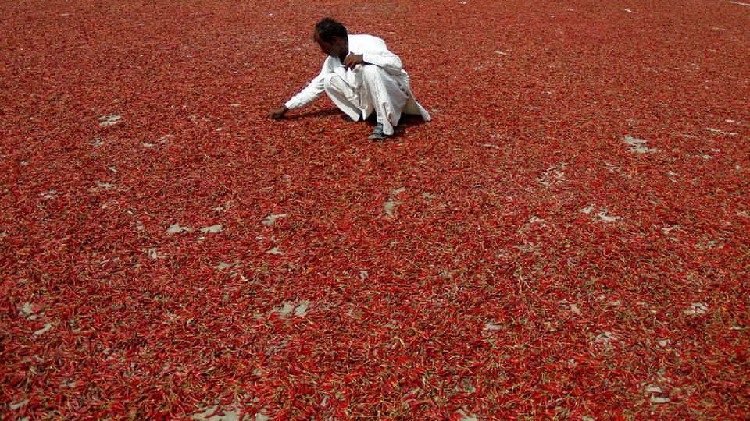
Hybrid vs Desi seed
Low productions of dandicut- although Dandicut holds unique taste, as highlighted by Shan Foods.
Shan Foods even offer premium price for Dandicut to encourage production.
Hybrid seeds have high yield, short-term interest of the farmers.
Hybrid seeds- modified so it affects soil productivity
Cross-pollination.
Hybrid requires less input, so cost goes down.
Dandicut require more care and work, farmers unwilling to put in this much work.
A comparison of prices showed that Dandicut is cheaper to produce but farmers are reluctant to use it because of its strict requirements and ongoing environmental changes, increasing the risk of crop failure.

Slide 7
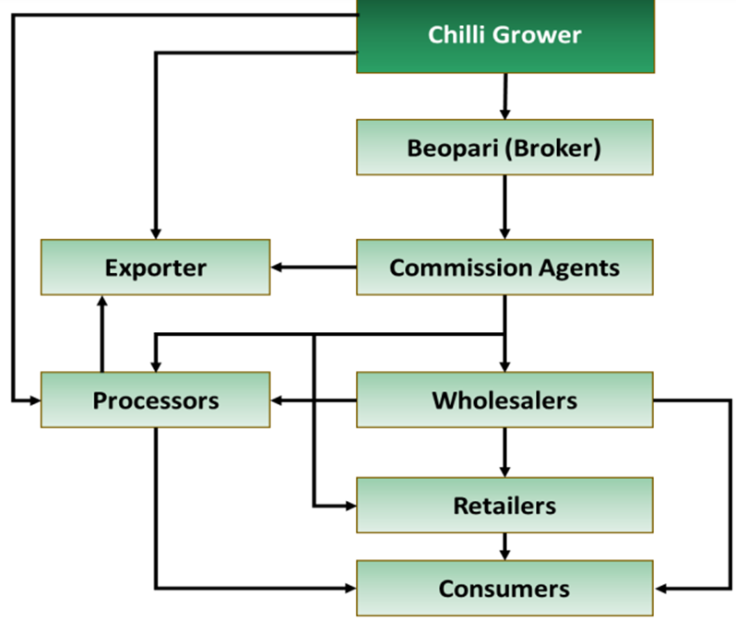
Value Chain
Input/Suppliers- Authorized dealers of fertilizers/pesticides & even some commission agents. Major recurring issue- the poor quality of seeds/fertilizers provided.
Growers- Dominated by small-medium growers. However, farmers now unwilling to produce red chili due to increase in cost.
Primary Wholesale Market- Refers to the market in the districts where the chili is grown. Kunri- the largest mirch mandi- Almost 90% chili produce is traded here. Aarthis, Traders & Brokers Chain dependent on credit- usually the Aarthi gives the credit to both the sellers & purchasers, increases Aarthis power in the chain. Growers earn only 40% to 45% of the amount paid by end consumers.

Slide 8
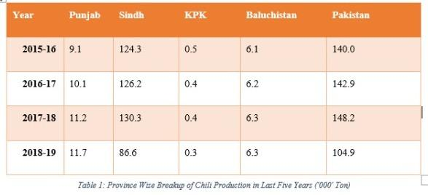
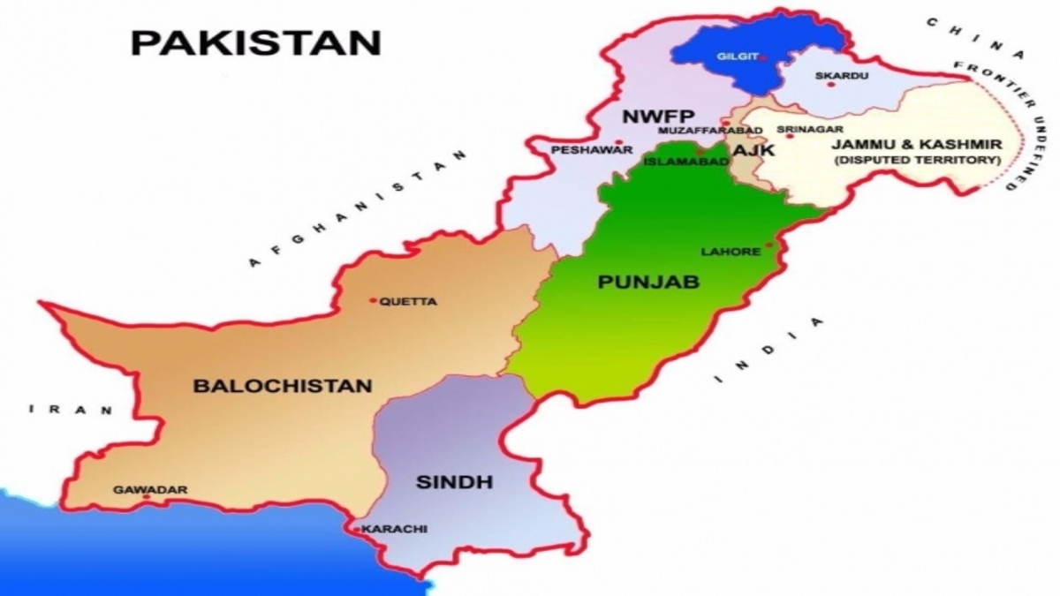
Domestic Market & Local production
Mirpurkhas, Umer Kot and Sanghar are the main hubs of red chili production
From Sindh, red chili is distributed all over the country via roads
Source: https://www.tridge.com/intelligences/other-chili-pepper/import

Slide 9
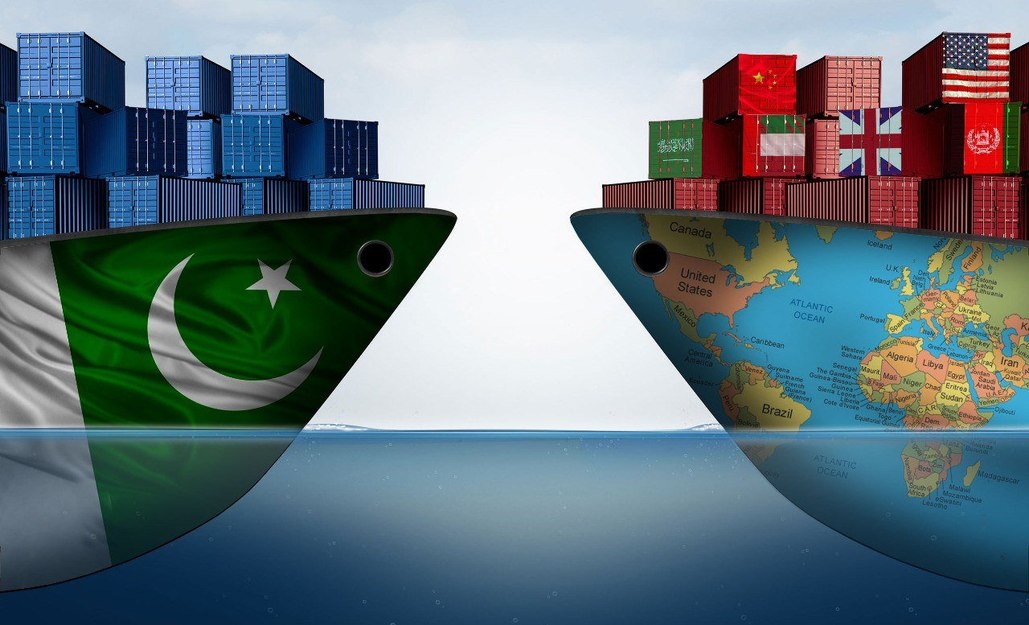
International Market
Total Global Production: 4.03M metric ton
Total Export Value: $6.19B
Total Import Value: $6.14B
Pakistan Status:
Pakistan’s Production Share: 141.54K metric ton (3.51%) Rank 6
Pakistan’s Exports Share: $1.07M (0.02%) Rank 59
Pakistan’s Imports Share: $893.7K (0.01%) Rank 72
Source: https://www.tridge.com/intelligences/other-chili-pepper/import

Slide 10
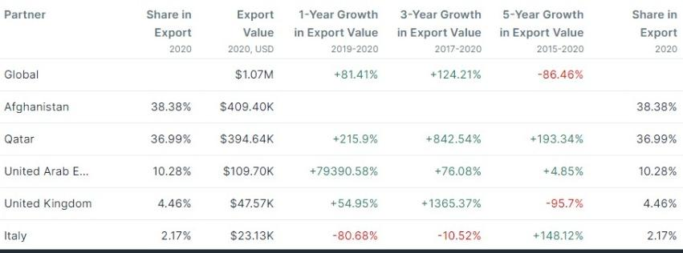
Export Partners
Currently, China is also investing which provides another export opportunity for Pakistan
Pilot chili field in Lahore
https://www.tridge.com/intelligences/other-chili-pepper/PK/export

Slide 11
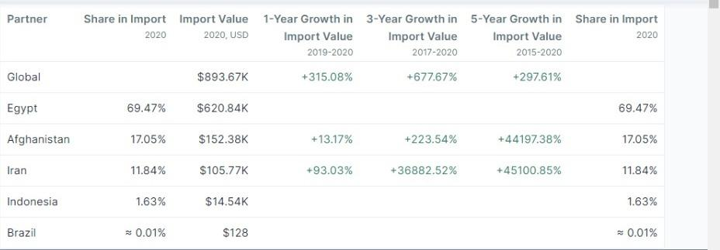
Import Partners
https://www.tridge.com/intelligences/other-chili-pepper/PK/import

Slide 12
Problems in Trade
Diseases attacks
Mycotoxins- Aflatoxin issue
Limited information regarding toxicological is available in Pakistan- few investigation
Decrease in overall produce since 2019 has increased price of chilies
Heat wave and Climate change
Poor farming practices- imbalance fertilizers
Mishandling of chili postharvest
Reduction in volume of chili has led to reduced exports

Slide 13
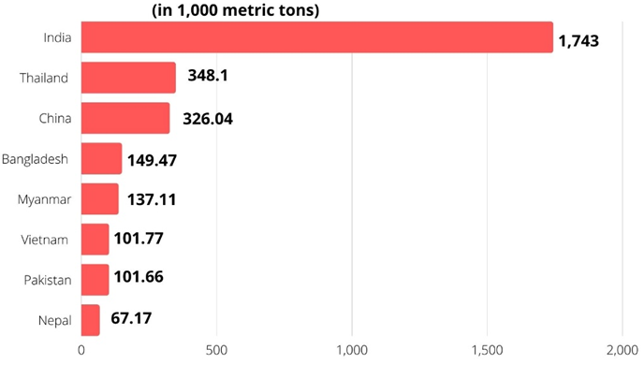
Chili Export to China
 | Chili Export (Tons) | Value (Millions)
FY 2016-17 | 5,905 | Rs.914.3
FY 2019-20 | 1,825 | Rs.581.3
Figure 8: Dry Chilies and Peppers Production in Asia Pacific -2019

Slide 14
Chili Export to China
CPEC Authority along with CMEC in 2020 conducted a pilot study at 100 acres of land.
The next step under this project is to cultivate 5000 acres of land with chili.
Chinese ambassador Nong Rong predicted that if Pakistani farmers follow these standards and receive the right number of resources, they will be able to produce more than 8,000 tons of dried chilies with a net income for over Rs. 100,000 per acre.
The export potential of Pakistan with China is high as sequential cropping is suitable in Pakistan where the climate, water, and soil are apt for chili production.
This is a drawback of China and opens export opportunities for Pakistan.

Slide 15
Business Areas

Slide 16
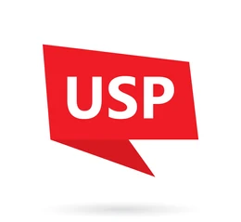
Contractual Farming
Problem:
Pakistani red chili market lacks quality produce
Charging Premium according to the quality of red chilies.
Rs 1000/mann for A quality
Rs 600/mann for B quality
Objective:
(Longi)
Pilot Study
In 2010, a similar practice was conducted, which resulted in an increase in yield of red chilies from 0.9 tonnes to 2.3 tonnes.

Slide 17
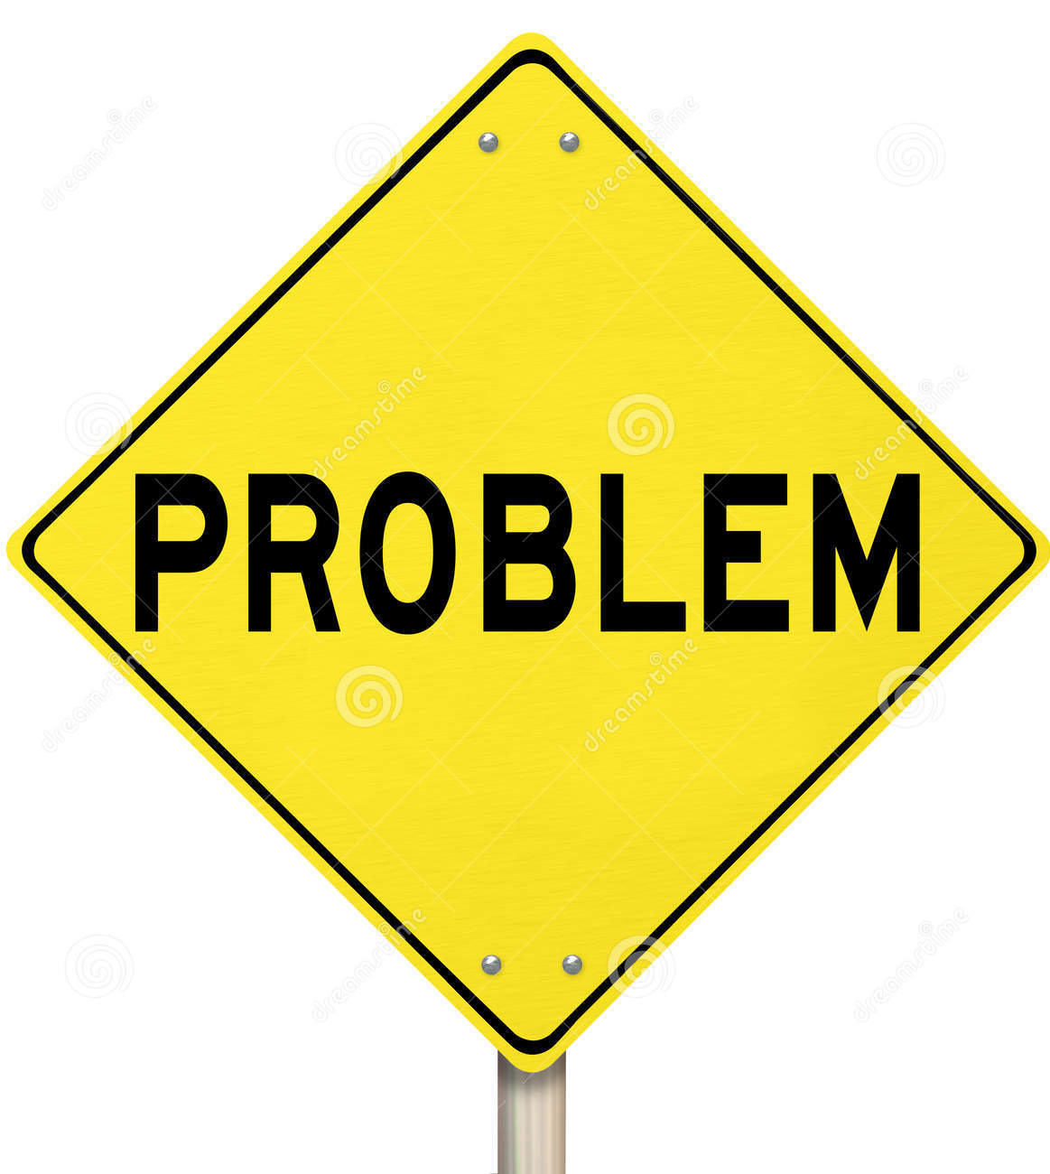
Seed Research
Pilot Study
Objective
Hybrid seed planted, Dandicut not planted that much. Original Dandicut lost over the time.
All stakeholders highlighted the issue of bad quality seed
National Seed Purification Project- Instructed farmers to follow geotextile strategy for drying. Seed purification- good pods selected and caged to stop ongoing cross pollination. Seed then distributed free of cost.
Business model pertaining to R&D of Seed→ for better yield. Meet the world/local demand for Dandicut Bring the original Dandicut back.
Capital investments from stakeholders/private investors & government help required.

Slide 18
Seed Research
Demand
The Researched seed can also be directly exported→ new revenue stream.
Training regarding Dandicut seed growth can also be provided to other countries.
“Desi toh desi hai, desi ki ziada achi hoti hai”
Target Market- Farmers (Pakistan), Private investors (contractual farming) & Other countries- China, Mexico or India
“Humarey paas abb yeh mirchi aisi agayi hai ke yahan 30 mann ki average ati hai”
Team of researchers.
State-of-art lab.
Investors- for resources.
Government.
“Jab shuru se hi wo bemaar hai, usspar kahan lagey ga fruit.”
Local demand- companies & traders. Export potential- US, UK, Saudi Arab, UAE, Bangladesh, and Sri Lanka, China

Slide 19
Recommendations
Training and SOPs for farmers
Improving pricing and loan mechanism
Regulator
Maintaining seed quality - R&D for seeds
Subsidy on transportation and land development
Main goal should be boosting exports to potential countries while maintaining international quality standards

Slide 20
Thank You!

